Slide 1


Zen
AI Habit Tracker

Slide 2


Problem Statement:
Users face challenges in managing their daily routines, as existing tools often lack integration and personalization in tracking habits, goals, and productivity.

Slide 3
Our Solution:
Our project provides a comprehensive solution with:
A Habit Tracker that seamlessly integrates habit and goal tracking.
A Note Taking Module and an AI Chatbot for efficient task management.
A Focus Mode that combines a Pomodoro timer with Zen Garden visualization to track progress.

Slide 4
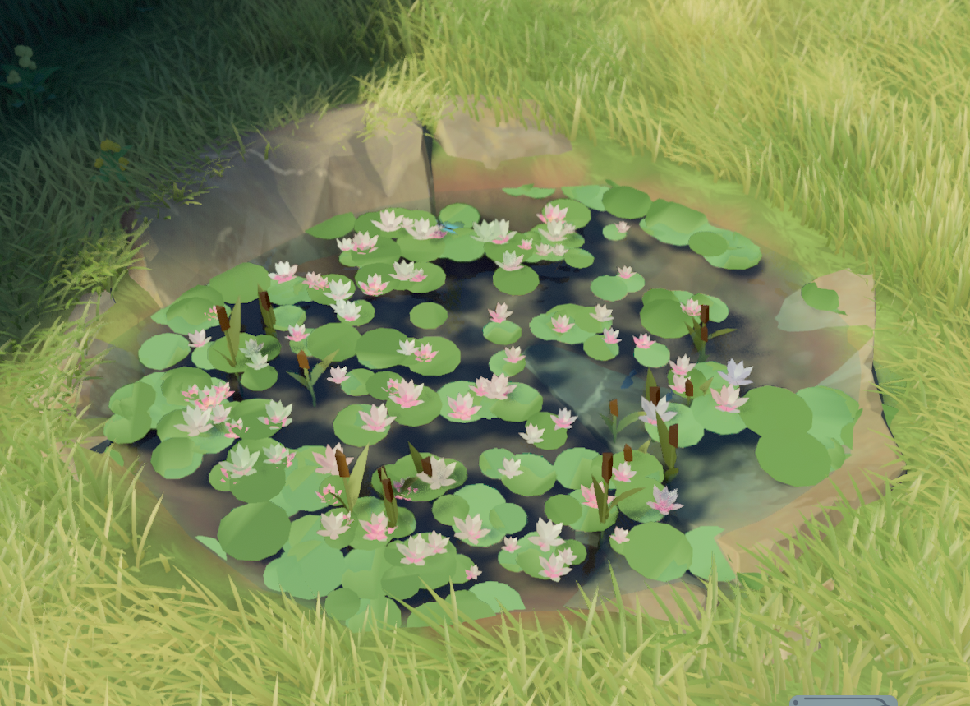
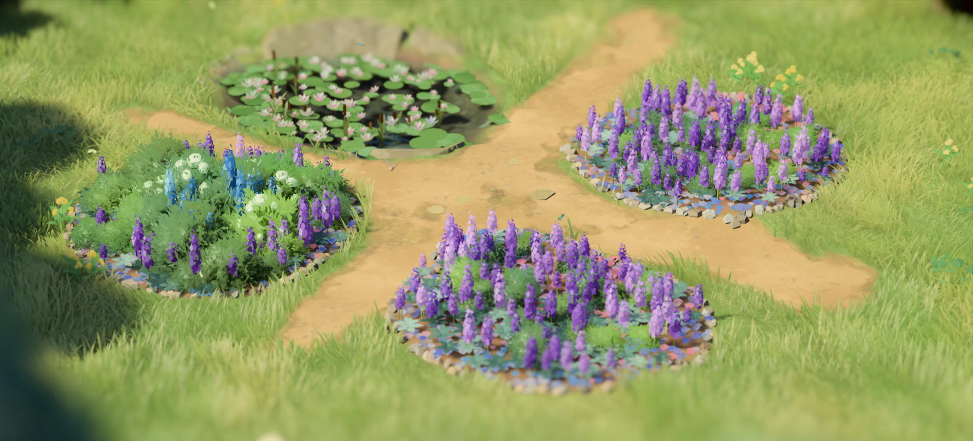
Zen Garden:
(This is just a representation that we have come up with. This only defines the functionality of the Garden)

Slide 7
Roles and Responsibilities:
Srachet Rai - Security & Front End
Adarsh Bajpai - Front End
Avijith Manikandan - AI Chat Bot
Anmol Ranjan - Back End
Abhi Bhardwaj - Database

Slide 8
Tech Stack:
Frontend (React.js) interacts with the Backend API.
Backend API (Node.js & Express.js) manages:
Authentication Module (OAuth/JWT) for user logins.
AI Assistant Module (LLM API) for habit recommendations.
Habit Management Module for tracking user habits.
Database (MongoDB) stores users, habits, logs, and AI recommendations.

Slide 9
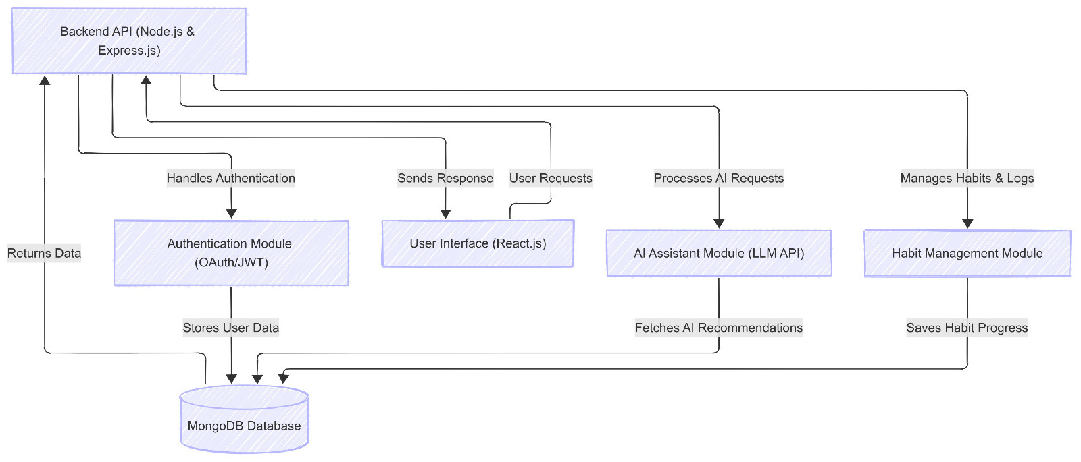

Slide 10
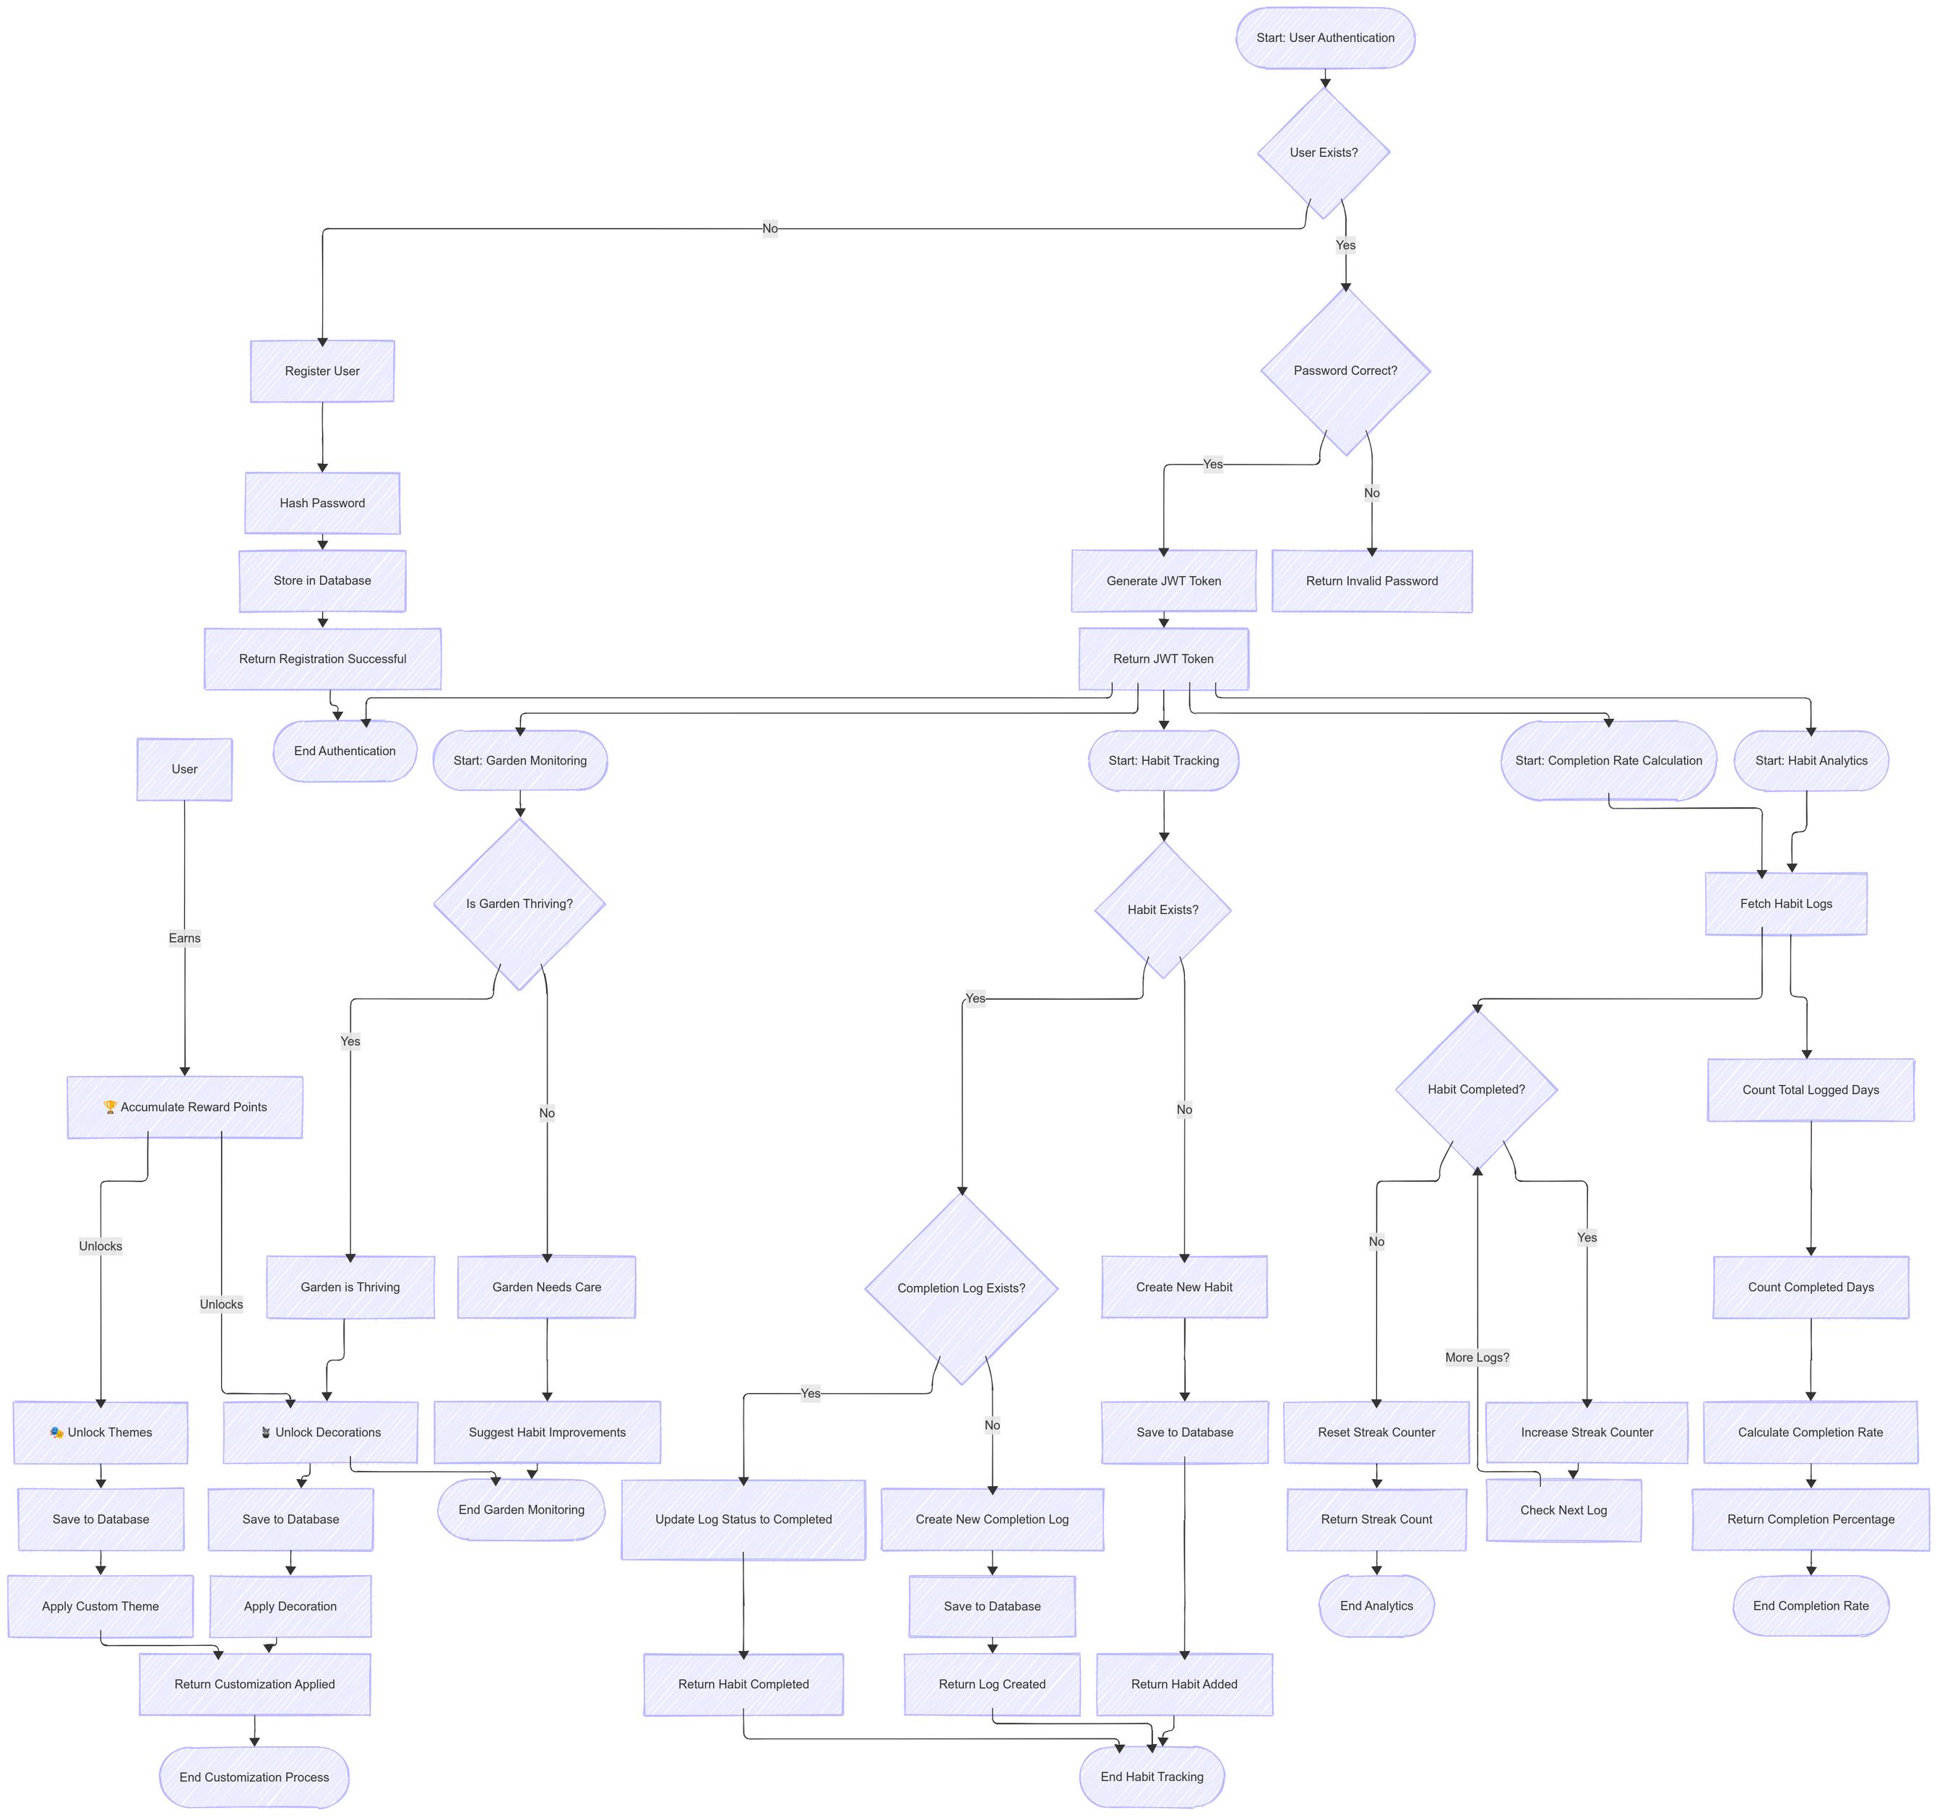
Flow of Execution

Slide 13
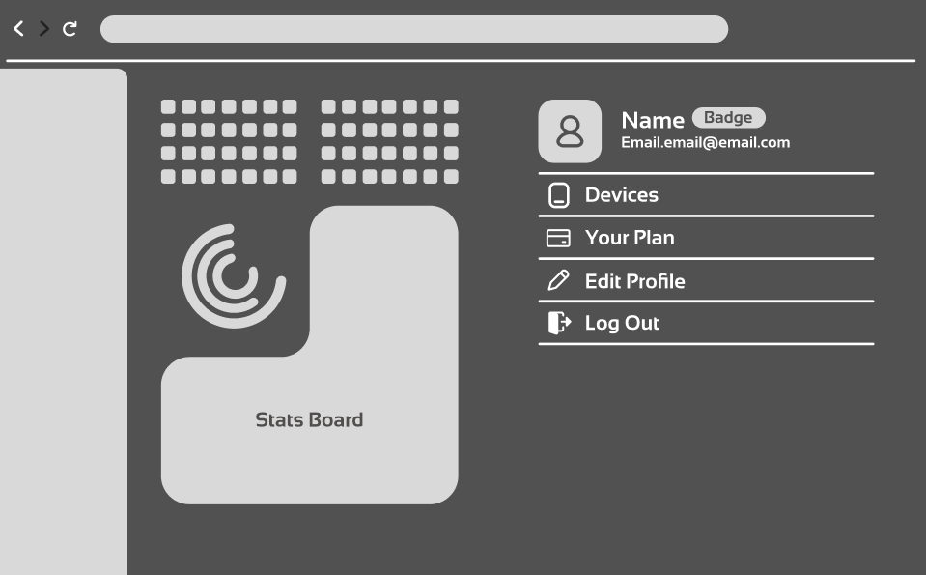
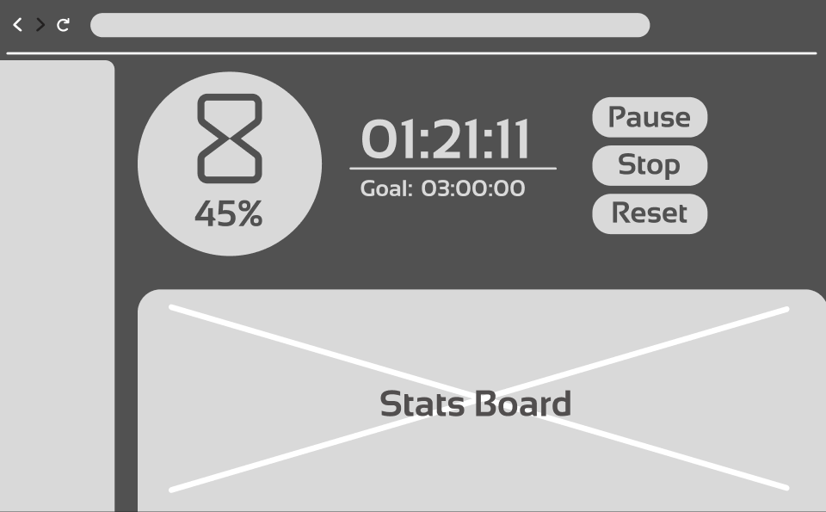
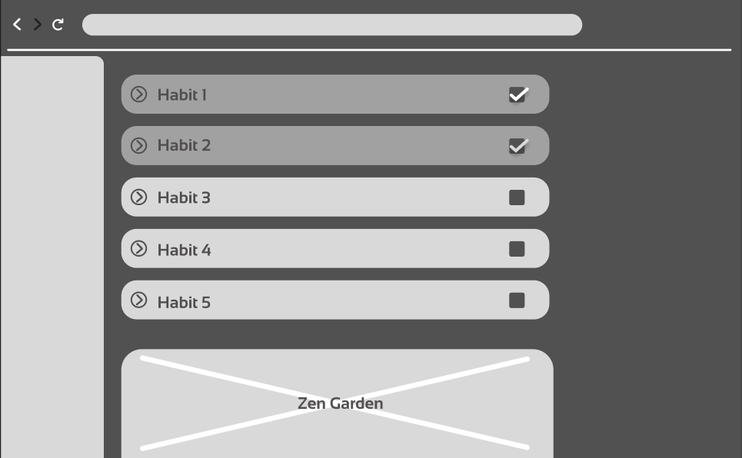
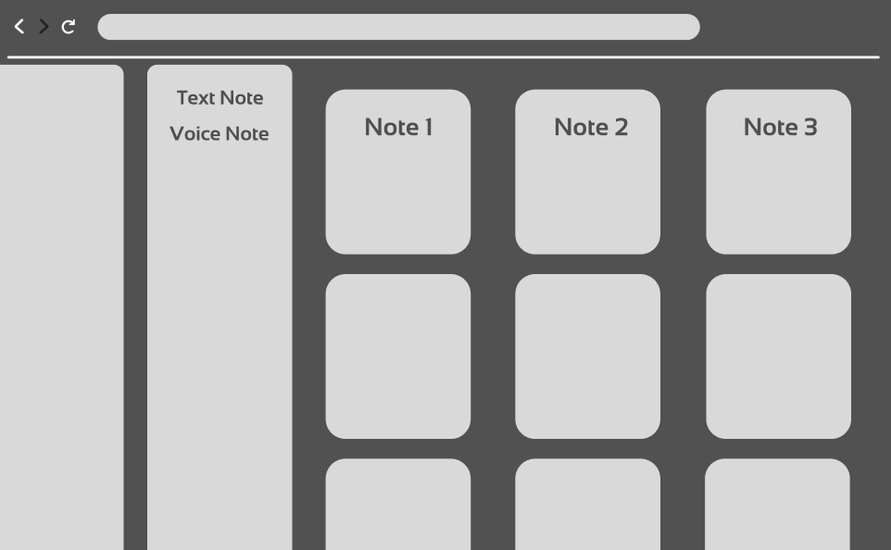
UI Wireframe/ Mockups:
This is the basic UI workflow we developed to visualize the final layout of the web application.

Slide 14
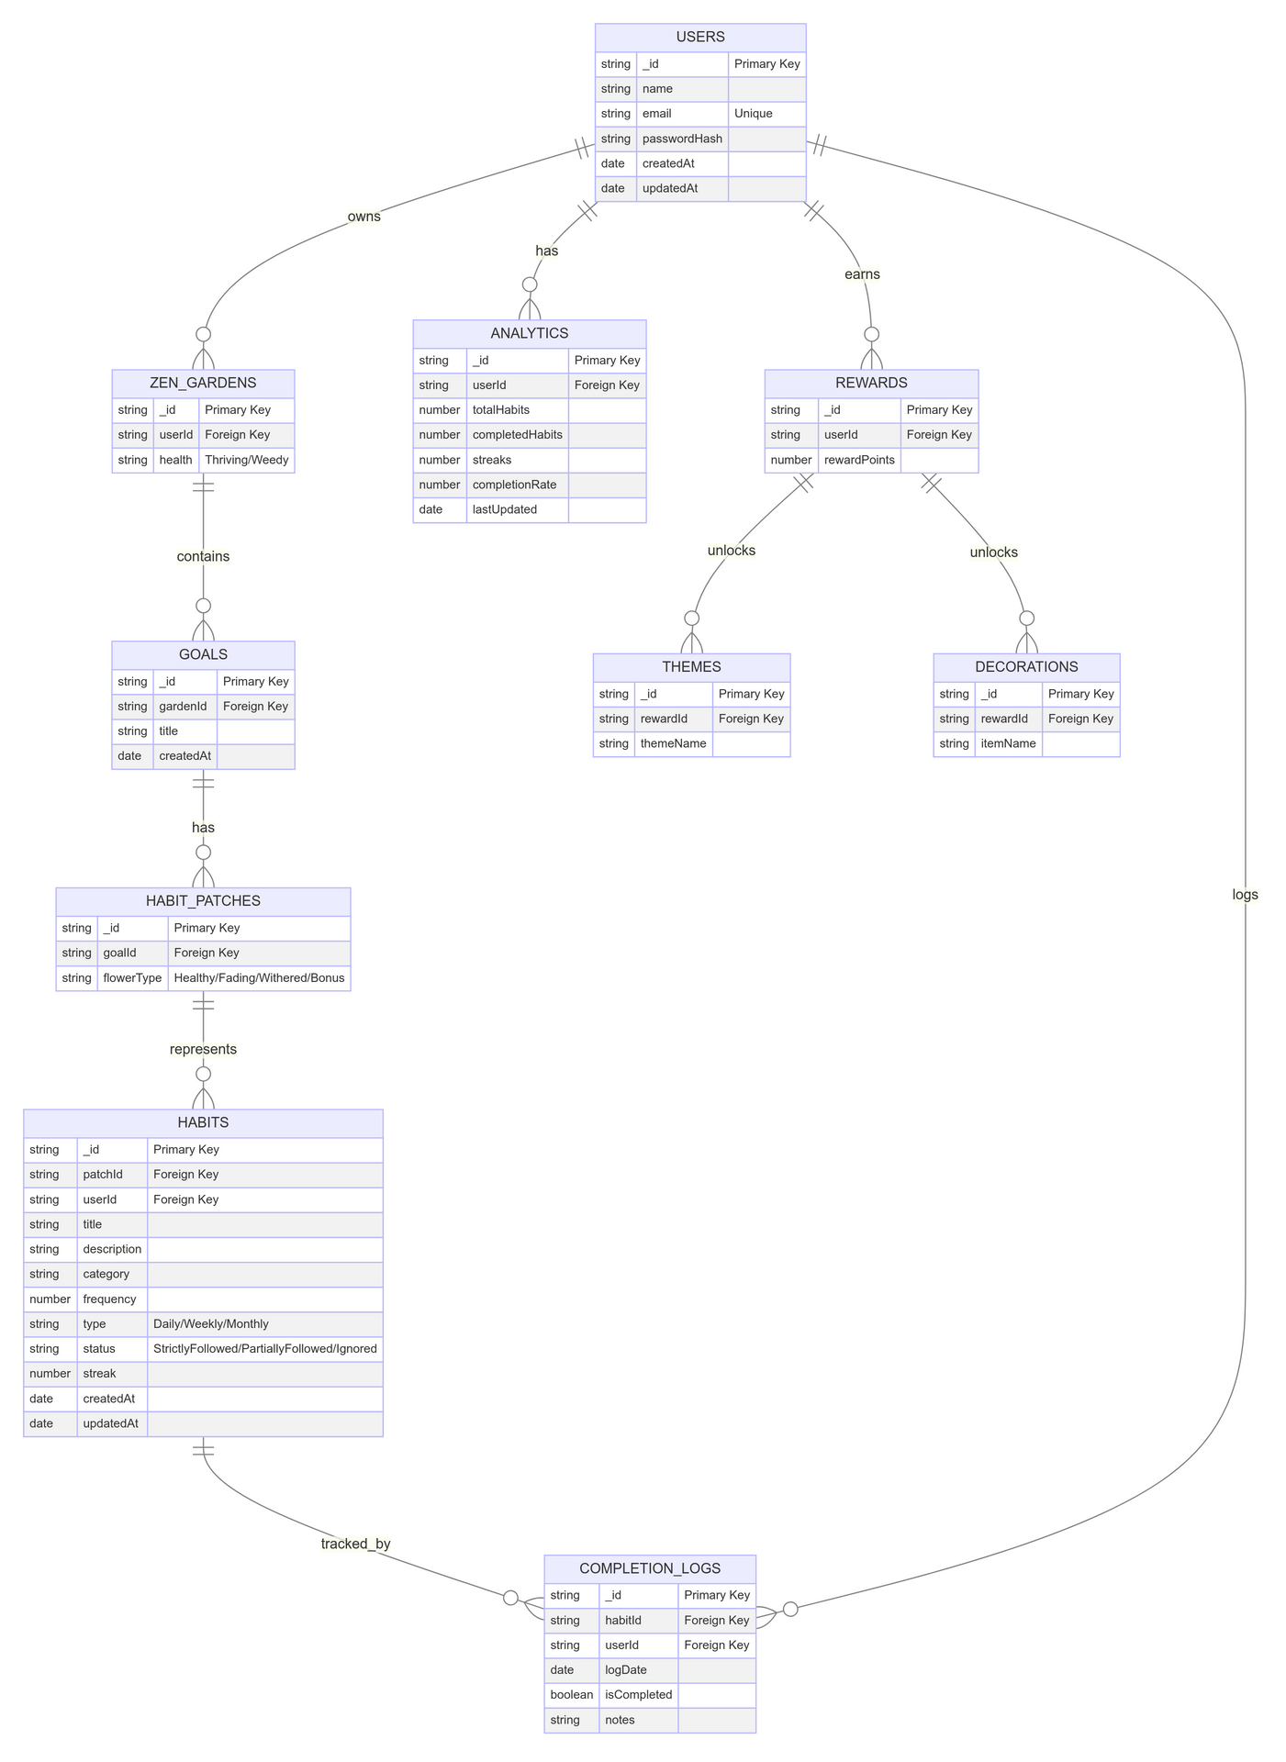
ER Diagram:

Slide 15
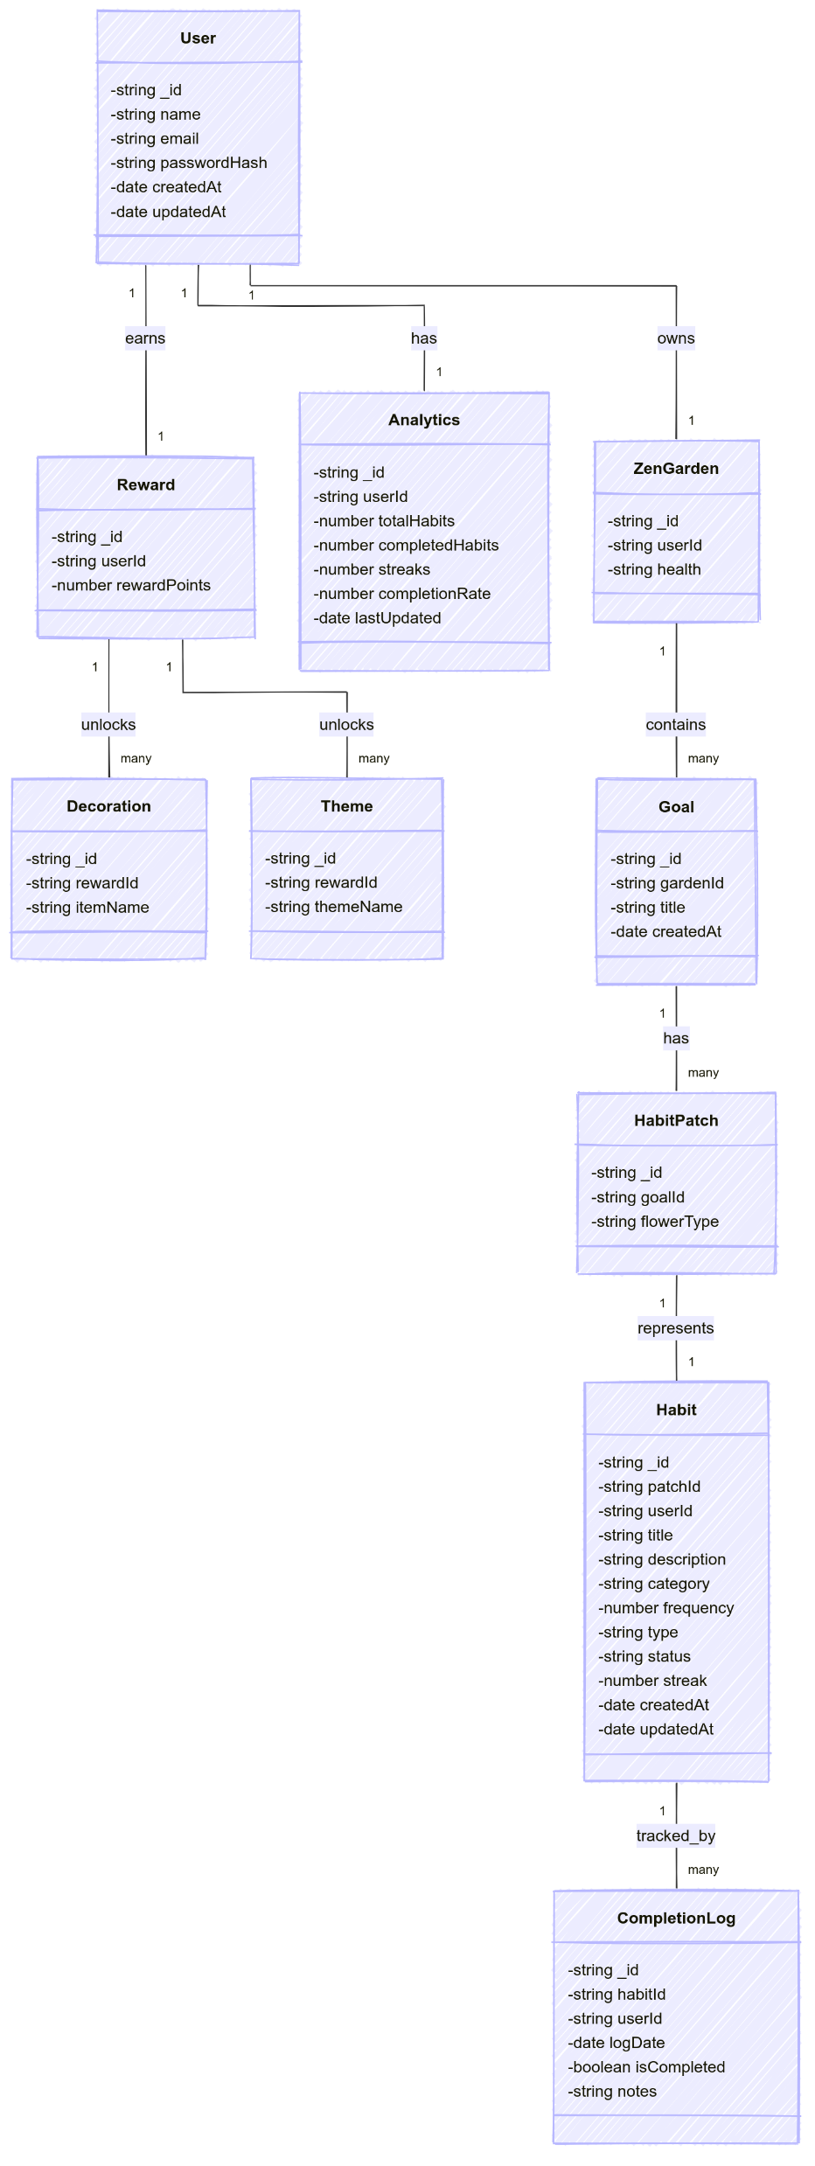
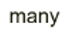





Class Diagram:

Slide 16
Progress:
Task Done | Done By
Project Discussion | 1st Feb
Finalizing Requirments | 9th Feb
Functionality Discussion | 12th Feb
SRS and SDD | 19th Feb
Presentation | 22nd Feb

Slide 17
Timeline:
Phase | Task/Activity | Date | Key Deliverables
Requirements & Planning | Finalize requirements, SDD, diagrams (ER, class), and requirements matrix. | Feb 24, 2025 | Complete SDD and documentation, finalized requirements matrix, ER & class diagrams.
System & UI Design | Create system architecture, UI wireframes, and design mockups (focusing on key UI buttons and interactions). | Mar 5, 2025 | Architecture diagrams and UI design sketches/mockups.
Database & Backend Development | Develop the database schema and implement core backend functionality (user auth, CRUD for goals/habits, etc.). | Mar 18, 2025 | Functional database schema and backend API endpoints for core operations.
Frontend Development | Build and integrate UI components with backend services; implement main UI buttons and interactions. | Mar 25, 2025 | Working user interface with key screens (authentication, dashboard, habit tracking, customization).
Integration & Testing | Integrate frontend with backend; perform unit and integration testing; fix bugs. | Apr 15, 2025 | A stable, integrated system with test results and bug fixes documented.
Final Report & Documentation | Prepare final project report, update documentation, and compile any demonstration materials (screenshots, videos). | Apr 28, 2025 | Final report, updated SDD, and all supporting documentation ready for submission.
Buffer & Final Adjustments | Last-minute tweaks and review to ensure all requirements are met and the final report is complete. | May , 2025 | Final polished project and documentation; project ready for academic submission.

Slide 18
Thank You
Abhi Bhardwaj
Adarsh Bajpai
Avijith Manikandan
Anmol Ranjan
Srachet Rai

